Slide 1
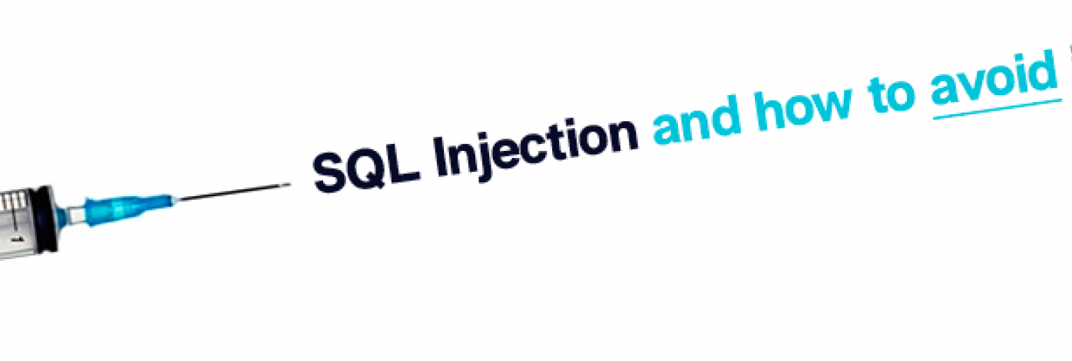
CWE 89 Improper Sanitization of Special Elements used in an SQL Command ('SQL Injection’)
M. Eng Tingjun W.
Chunyang J.
Xiaoxuan Y.

Slide 2
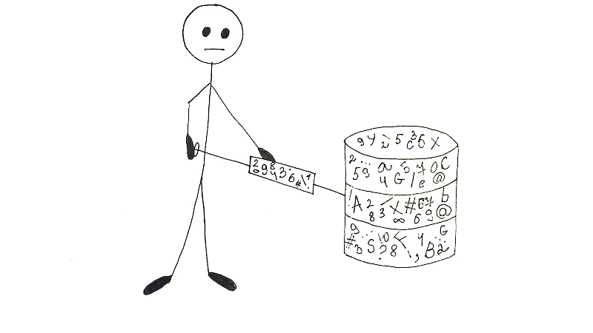
Content
Description
Common consequence
Relation and Attack patterns
Demonstrative Examples
Potential mitigations
Demo

Slide 3

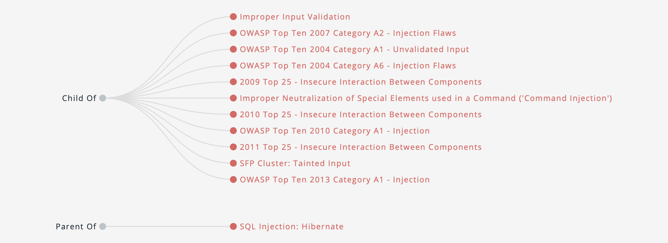
What is CWE 89
Top in the list of Top 25 most dangerous software errors
The basic form of SQL injection
Attackers can tamper with the original query by permanently terminating the string, appending new commands
Notes:
describes direct insertion of attacker-controlled data into variables that are used to construct SQL commands

Slide 4
Common Consequence
Scope | Technical Impact
Confidentiality | Read Application Data
Access Control | Bypass Protection Mechanism
Integrity | Modify Application Data
Notes:
The common consequences of this particular weakness area listed as follows
1) Confidentiality: Since SQL databases generally hold sensitive data, loss of confidentiality is a frequent problem with SQL injection vulnerabilities. SQL injection enables one the access to the restricted part of the database and that generally leads to the access to the confidential information.
2) Usually, access controls require certain interaction with the SQL database. It is possible through SQL injection to bypass these controls and gain illicit access to controlled areas.
Authentication: If poor SQL commands are used to check user names and passwords, it may be possible to connect to a system as another user with no previous knowledge of the password.
Authorization：If authorization information is held in a SQL database, it may be possible to change this information through the successful exploitation of a SQL injection vulnerability.
3) Integrity:A successful SQL injection is not just interacting and showing the table but is also capable of modifying them. The integrity of a vulnerable application should not be trusted for integrity.
Just as it may be possible to read sensitive information, it is also possible to make changes or even delete this information with a SQL injection attack.

Slide 5

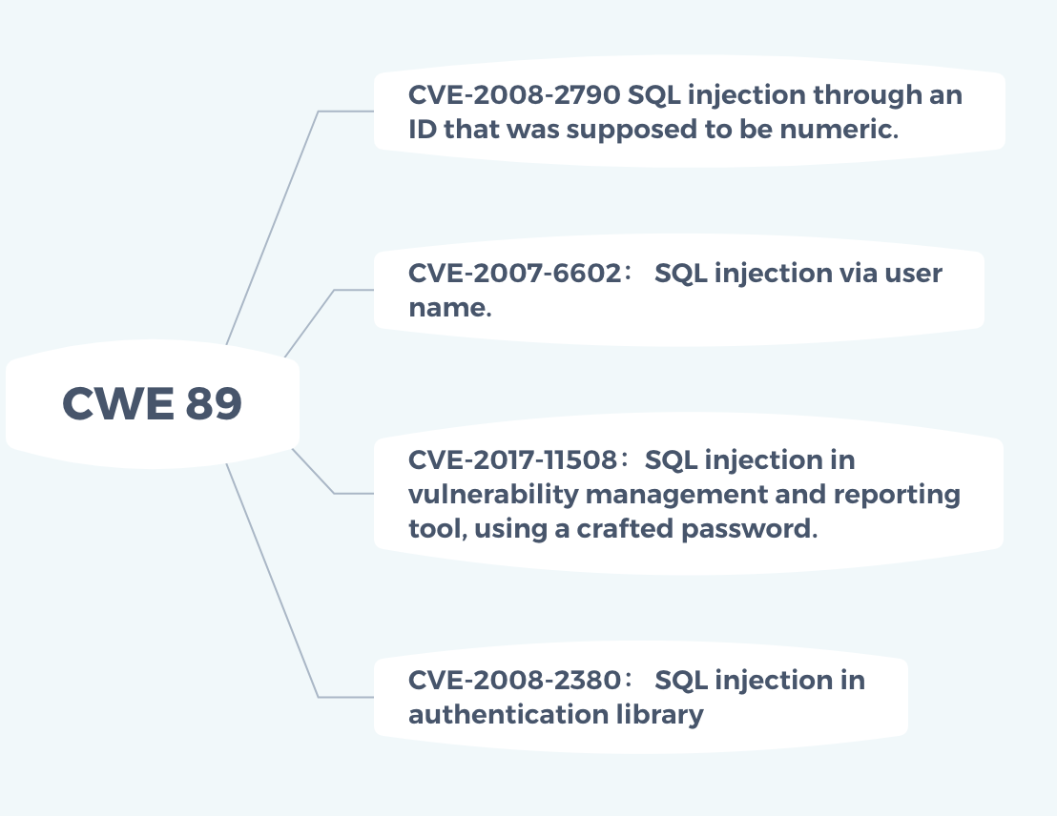
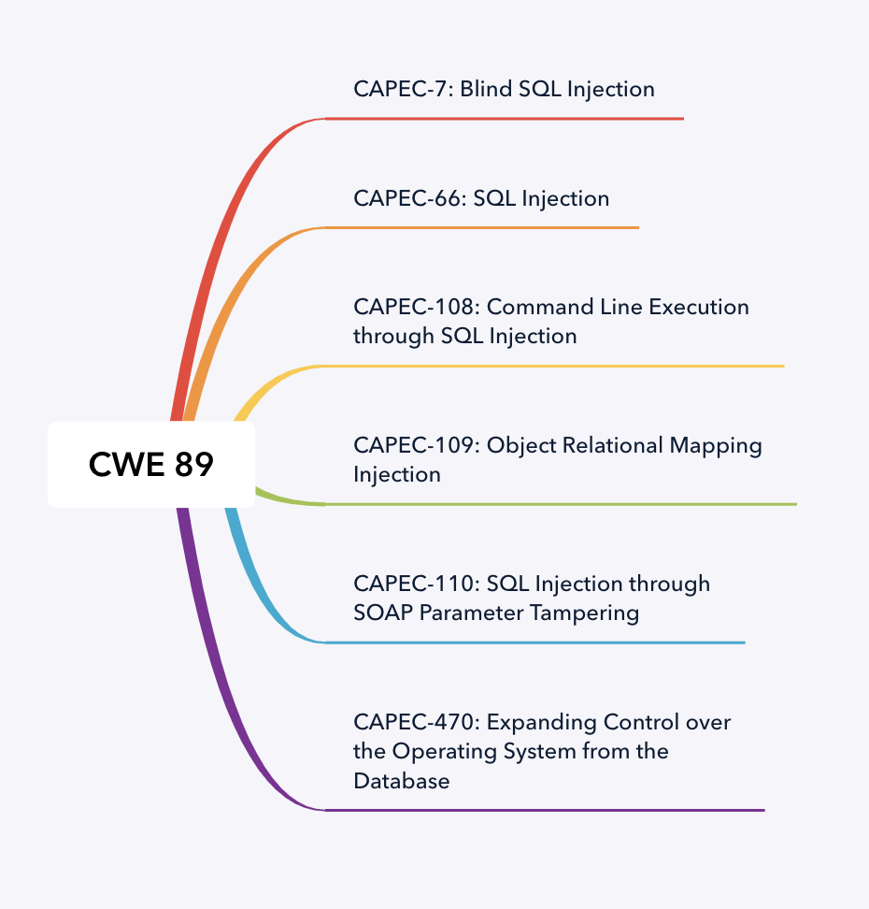



Relation and Attack Pattern
Notes:
The examples that are observed over the years have been placed into the CVE. Some of these examples are given on the CWE-89 page as follows:
The actual listing has around 5000 entries in this category. This shows that the sql injections are actually observed in the works of experienced developers too.
2. An attacker exploits this weakness in software that constructs SQL commands based on user input. According to CAPEC classification there are the following attack patterns: Common Attack Pattern Enumeration and Classification (CAPEC™)

Slide 6
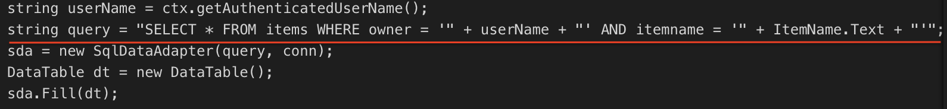
Demonstrative Example 1
Intent to execute:
SELECT * FROM items WHERE owner = <userName> AND itemname = <itemName>;
user name wiley enters： name' OR 'a'=‘a
The above query change to :
SELECT * FROM items WHERE owner = 'wiley' AND itemname = 'name' OR 'a'='a’;
Which is same as :
SELECT * FROM items;
(query now returns all entries stored in the items table)
Notes:
this code is to run the following sql query.
2. However, because the query is constructed dynamically by concatenating a constant base query string and a user input string, the query only behaves correctly if itemName does not contain a single-quote character. If an attacker with the user name wiley enters the string:
3. then the query becomes the following:
4. The addition of the:OR 'a'=‘a, causes the WHERE clause to always evaluate to true.
5. This simplification of the query allows the attacker to bypass the requirement that the query only return items owned by the authenticated user; the query now returns all entries stored in the items table, regardless of their specified owner.

Slide 7
Demonstrative Example 2 Shell command execution
Query :
User provides : '; exec master..xp_cmdshell 'dir’ –
Then query:
Become three parts:
A first SQL query
A second SQL query: exec master..xp_cmdshell 'dir’
An MS SQL comment:
Notes:
1. This example takes an adversary outside the database and give access to shell commands themselves. It is about the MS SQL which has a built in function to execute shell commands. They demonstrate how one can exploit a command like:
2. As can be seen, the malicious input changes the semantics of the query into a query, a shell command execution and a comment.and it execute the dir command in shell through MS SQL.

Slide 8
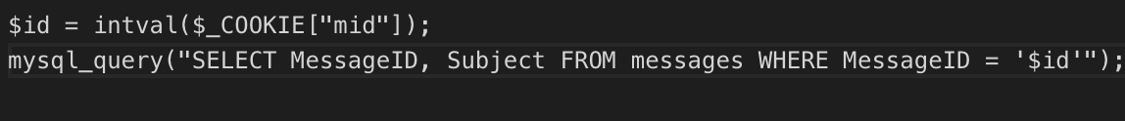
Demonstrative Example 3 Print a message summary given the message ID
Attack code: 1432' or '1' = ‘1
Resulting query:
Retrieve all other messages
Eliminate this injection:
Notes:
This code intends to print a message summary given the message ID. This example shows the execution of sql injection through exploitation of cookies instead of fields. The example on PHP is the following:
where, the developers might have missed the input validation with an assumption that the cookies cannot be modified by the attacker.
2. The programmer may have skipped any input validation on $id under the assumption that attackers cannot modify the cookie. However, this is easy to do with custom client code or even in the web browser.
While $id is wrapped in single quotes in the call to mysql_query(), an attacker could simply change the incoming mid cookie to:
And a simple replacement of cookies may execute the following:
3. This would produce the resulting query:
4. Not only will this retrieve message number 1432, it will retrieve all other messages.
In this case, the programmer could apply a simple modification to the code to eliminate the SQL injection:

Slide 9
Mitigations Phase: Architecture and Design
Strategy: Libraries or Frameworks
does not allow the weakness to occur or provide some constructors that makes the weakness easier to avoid. (Hibernate , Enterprise Java Beans)
Strategy: Parametrization
automatically enforce the separation between data and code
Strategy: Repetition of client-side security checks onto the server
the attacker will not be able to bypass these security checks on client side
Notes:
1.
2. They recommend, based on availability, the usage of structured mechanisms that automatically separates the data from the code, and are able to provide the relevant quoting, encoding, and validation automatically. This reduces the reliance on the developer to provide this capability where ever an output is produced.
If available, use structured mechanisms that automatically enforce the separation between data and code. These mechanisms may be able to provide the relevant quoting, encoding, and validation automatically, instead of relying on the developer to provide this capability at every point where output is generated.
Process SQL queries using prepared statements, parameterized queries, or stored procedures. These features should accept parameters or variables and support strong typing. Do not dynamically construct and execute query strings within these features using "exec" or similar functionality, since this may re-introduce the possibility of SQL injection.
3. They recommend that the security checks performed on the client-side should be duplicated on the server so that the attacker will not be able to bypass these security checks on client side and feed in malicious values to the server.
For any security checks that are performed on the client side, ensure that these checks are duplicated on the server side, in order to avoid CWE-602. Attackers can bypass the client-side checks by modifying values after the checks have been performed, or by changing the client to remove the client-side checks entirely. Then, these modified values would be submitted to the server.

Slide 10
Mitigations Phase: Implementation
Strategy: Encrypt sensitive data
Sensitive information that maybe valuable to attackers will lose value.
Strategy: Input Validation
Never trust user input! The usage of “accept known good” or whitelisting, while rejecting all other values is seen as the best solution when available.
Blacklist malicious hosts
Block requests from suspicious IP address
Notes:
To address those cases where the dynamically generated queries, which although risky but becomes a requirement, the suggestion given by Mitre is to ensuring that the arguments are quoted and the special characters are escaped. They also point out that the most conservative one can go is to escape or filter all those character that do not pass an extremely strict whitelist. Also, if the special characters are required then one can wrap each argument in quote after an escaping/filtering step.
The recommendation of Mitre is the assumption that all input is malicious. The usage of “accept known good” or whitelisting, i.e. use of whitelist values which conforms to the strictest of the specification while rejecting all other values is seen as the best solution when available.

Slide 11

Demo
Attack :
http://www.smtmax.com/category.php?id=15

Slide 12
Thank you

